Slide 1
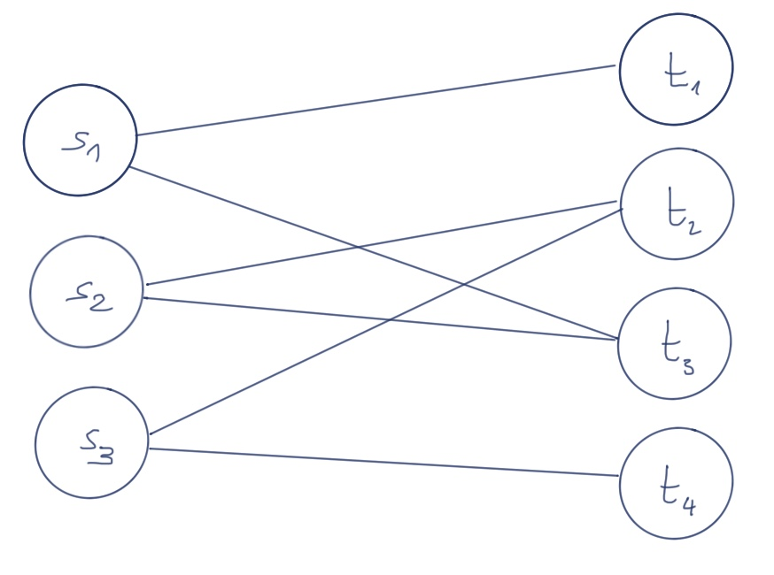
Algorithmic Matching
Mathematical approaches to optimally allocate topics to students
Frederik Heck
Coached by Simon Kramer

Slide 2
The Student-Topic-Assignment Problem
Students
Topics
… want to be assigned to …

Slide 3
Solution for Assignement Problems?

Slide 4
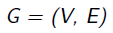
Solution for Assignement Problems?
Mathematics!

Slide 5

Solution for Assignement Problems?
Mathematics!
Most of the information bases on Allen Tuckers - Applied Combinatorics
https://www.wiley.com/en-us/Applied+Combinatorics%2C+6th+Edition-p-9781118210116

Slide 6
The Approach

Slide 7
The Approach
Phase I: Model the Problem

Slide 8
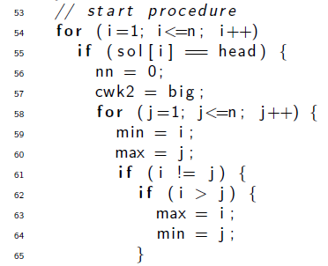
The Approach
Phase I: Model the Problem
Phase II: Solve the Model

Slide 9
Phase I - Model the Problem
First Step: Make a graph

Slide 10
Phase I - Model the Problem
First Step: Make a graph
A graph G consists of two sets V and E
V: Vertices
E: Edges (connecting vertices)

Slide 11
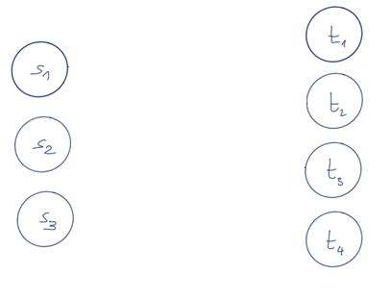
Phase I - Model the Problem
First Step: Make a graph
A graph G consists of two sets V and E
3 students
4 topics
V: Vertices
E: Edges (connecting vertices)
This graph has 7 vertices and no edges

Slide 12
Phase I - Model the Problem
First Step: Make a graph
Edges represent topic wishes
A graph G consists of two sets V and E
3 students
4 topics
V: Vertices
E: Edges (connecting vertices)
This graph has 7 vertices and 6 edges

Slide 13
Phase I - Model the Problem
Second Step: Transform the graph into a network

Slide 14
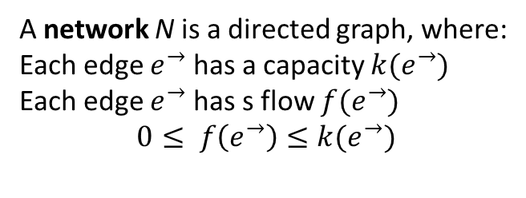
Phase I - Model the Problem
Second Step: Transform the graph into a network
A network N is a directed graph, where:
Each edge $e^{→}$ has a capacity $k(e^{→})$
Each edge $e^{→}$ has s flow $f(e^{→})$
$$0≤ f\left(e^{→}\right)≤k(e^{→})$$

Slide 15
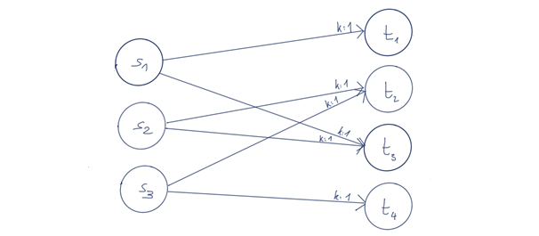
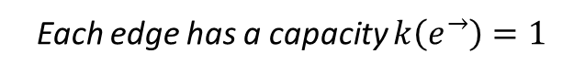
Phase I - Model the Problem
Second Step: Transform the graph into a network
Edges are directed now
A network N is a directed graph, where:
Each edge $e^{→}$ has a capacity $k(e^{→})$
Each edge $e^{→}$ has s flow $f(e^{→})$
$$0≤ f\left(e^{→}\right)≤k(e^{→})$$
Each edge has a capacity $k\left(e^{→}\right)=1$

Slide 16
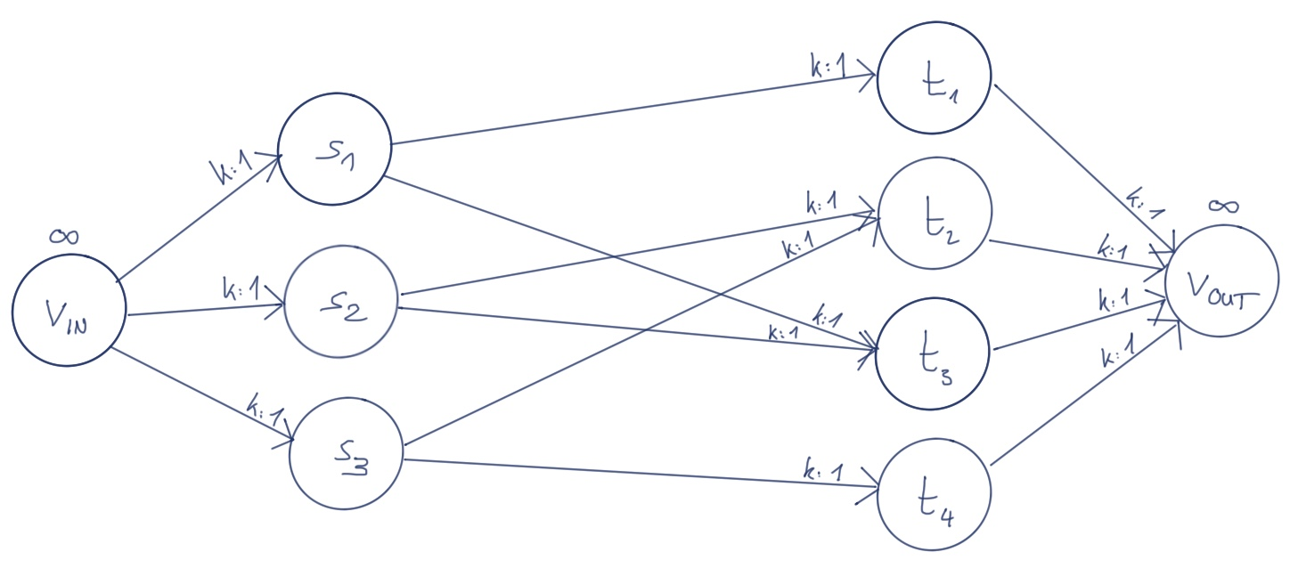
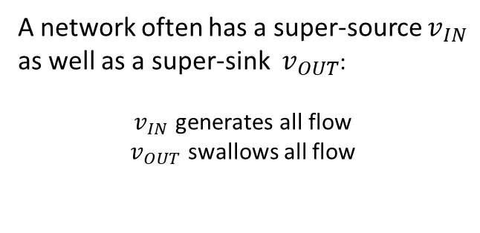
Phase I - Model the Problem
Second Step: Transform the graph into a network
We add a super-source and -sink
A network N is a directed graph, where:
Each edge $e^{→}$ has a capacity $k(e^{→})$
Each edge $e^{→}$ has s flow $f(e^{→})$
$$0≤ f\left(e^{→}\right)≤k(e^{→})$$
A network often has a super-source $v_{IN}$
as well as a super-sink $v_{OUT}$:
$v_{IN}$ generates all flow
$v_{OUT}$ swallows all flow
Each edge has a capacity $k\left(e^{→}\right)=1$

Slide 17
Phase II – Solve the Model
First Step: Understand Matchings

Slide 18
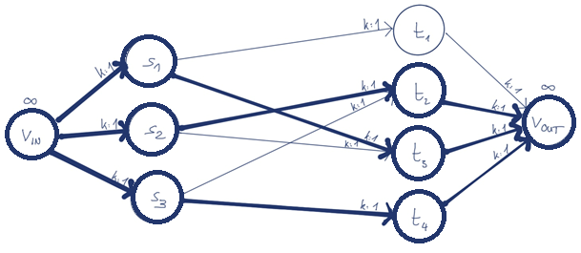
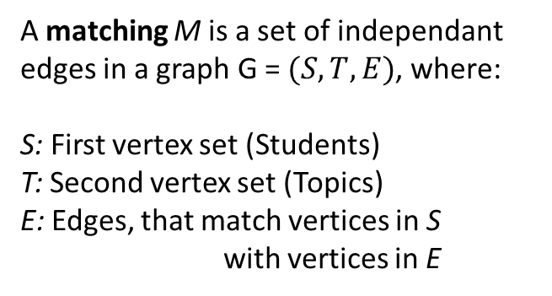
Phase II – Solve the Model
First Step: Understand Matchings
Thick lines represent a matching
A matching M is a set of independant edges in a graph G = $(S, T, E)$, where:
S: First vertex set (Students)
T: Second vertex set (Topics)
E: Edges, that match vertices in S with vertices in E
Every student is matched: Optimal!

Slide 19
Phase II – Solve the Model
Second Step: Develop an Algorithm
Augmenting Flow Algorithm

Slide 20
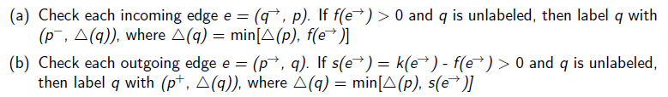
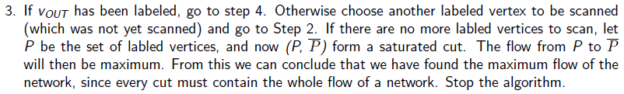
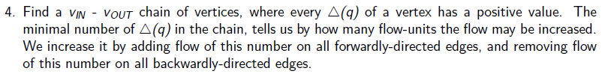
Phase II – Solve the Model
Second Step: Develop an Algorithm
Augmenting Flow Algorithm

Slide 21
Phase II – Solve the Model
Second Step: Develop an Algorithm
Augmenting Flow Algorithm
INIT
LABEL
CHECK
REPEAT

Slide 22
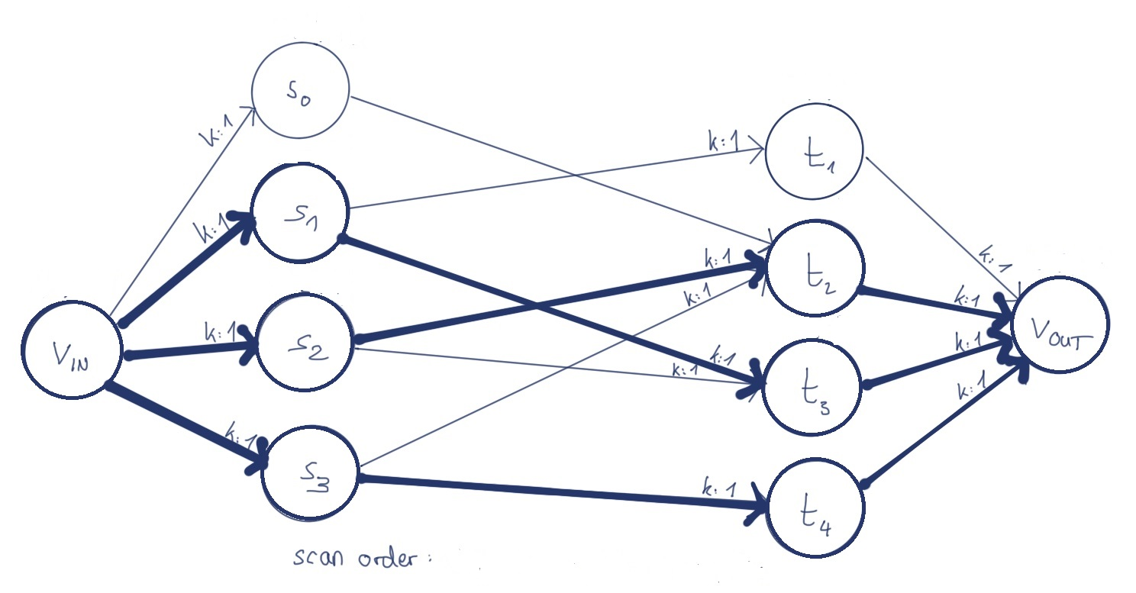
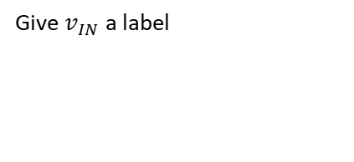
Phase II – Solve the Model
Second Step: Develop an Algorithm
Augmenting Flow Algorithm
INIT
Give $v_{IN}$ a label

Slide 23
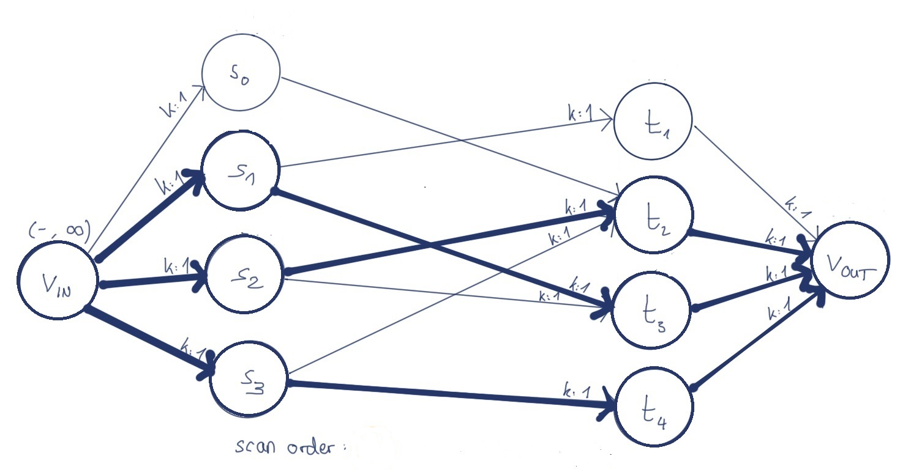
Phase II – Solve the Model
Second Step: Develop an Algorithm
Augmenting Flow Algorithm
INIT
Give $v_{IN}$ a label

Slide 24
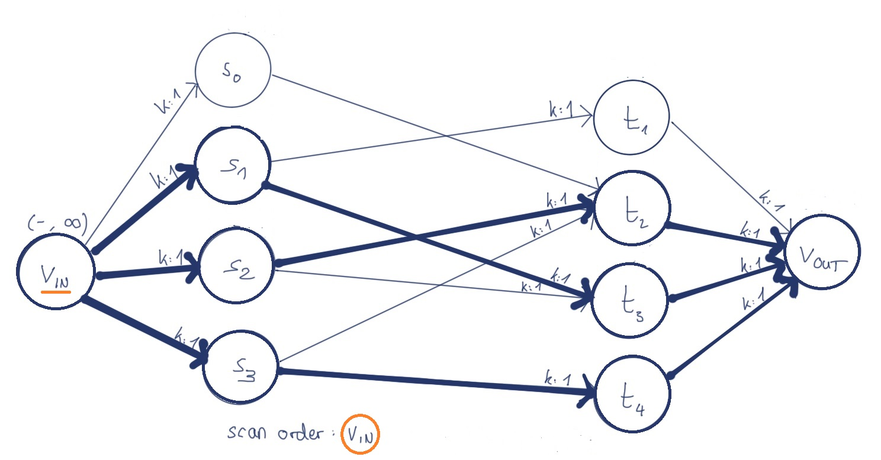
Phase II – Solve the Model
Second Step: Develop an Algorithm
Augmenting Flow Algorithm
LABEL

Slide 25
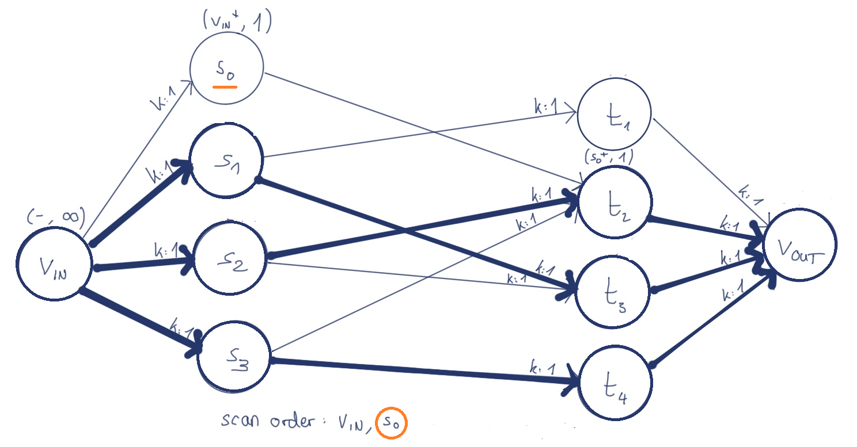
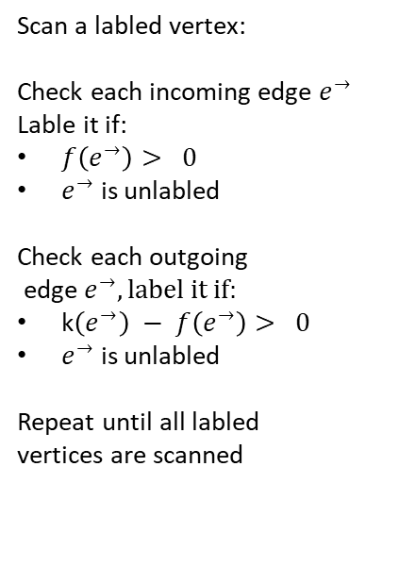
Phase II – Solve the Model
Second Step: Develop an Algorithm
Augmenting Flow Algorithm
LABEL
Scan a labled vertex:
Check each incoming edge $e^{→}$
Lable it if:
$f\left(e^{→}\right)> 0$
$e^{→}$ is unlabled
Check each outgoing
edge $e^{→}, label it if:$
k$\left(e^{→}\right) − f\left(e^{→}\right)> 0$
$e^{→}$ is unlabled
Repeat until all labled vertices are scanned

Slide 26
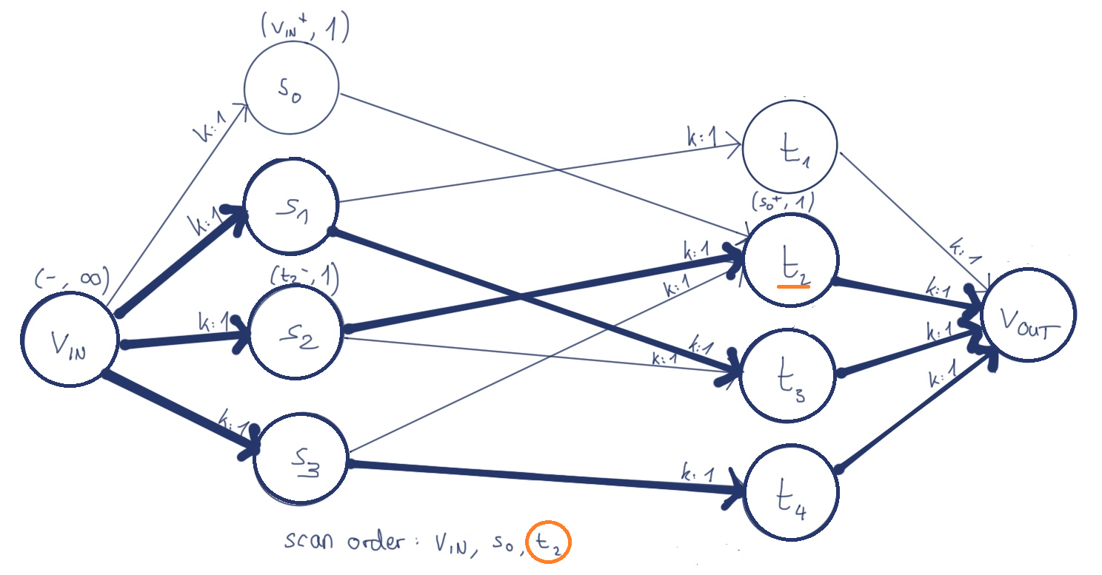
Phase II – Solve the Model
Second Step: Develop an Algorithm
Augmenting Flow Algorithm
LABEL
Scan a labled vertex:
Check each incoming edge $e^{→}$
Lable it if:
$f\left(e^{→}\right)> 0$
$e^{→}$ is unlabled
Check each outgoing
edge $e^{→}, label it if:$
k$\left(e^{→}\right) − f\left(e^{→}\right)> 0$
$e^{→}$ is unlabled
Repeat until all labled vertices are scanned

Slide 27
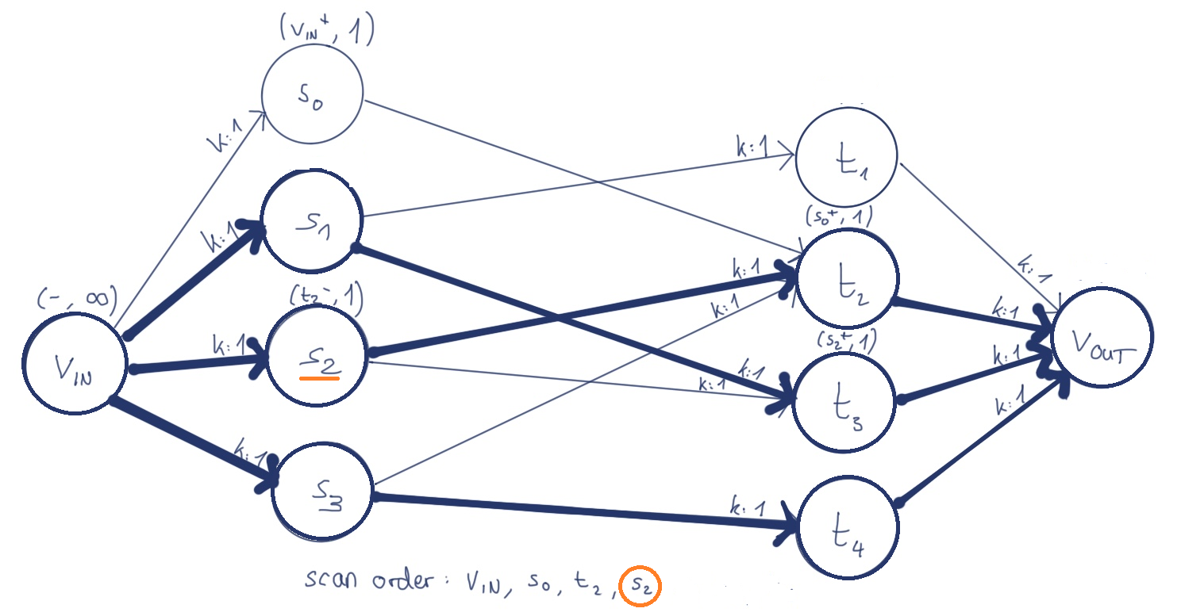
Phase II – Solve the Model
Second Step: Develop an Algorithm
Augmenting Flow Algorithm
LABEL
Scan a labled vertex:
Check each incoming edge $e^{→}$
Lable it if:
$f\left(e^{→}\right)> 0$
$e^{→}$ is unlabled
Check each outgoing
edge $e^{→}, label it if:$
k$\left(e^{→}\right) − f\left(e^{→}\right)> 0$
$e^{→}$ is unlabled
Repeat until all labled vertices are scanned

Slide 28
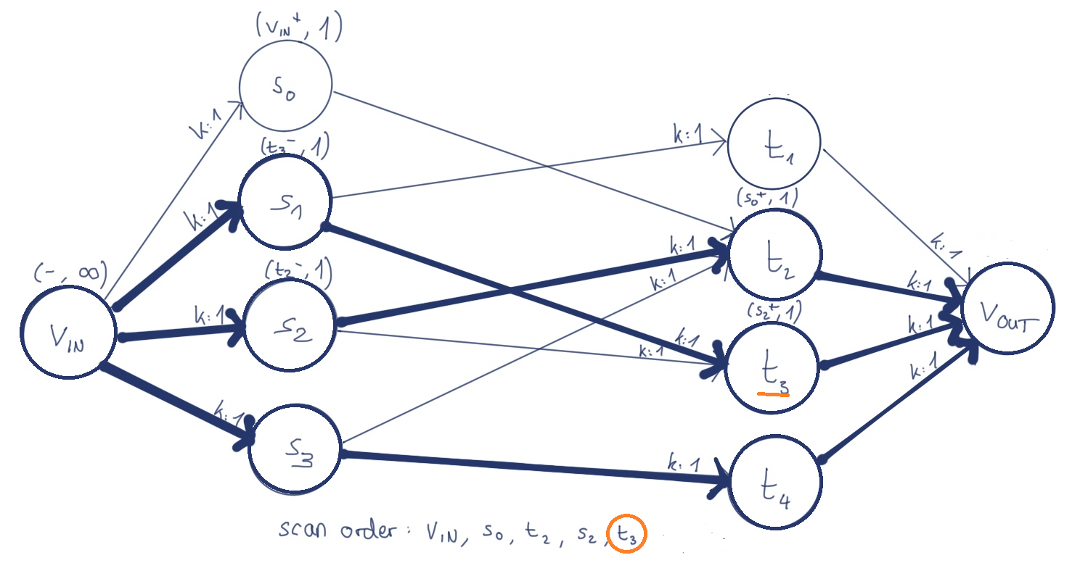
Phase II – Solve the Model
Second Step: Develop an Algorithm
Augmenting Flow Algorithm
LABEL
Scan a labled vertex:
Check each incoming edge $e^{→}$
Lable it if:
$f\left(e^{→}\right)> 0$
$e^{→}$ is unlabled
Check each outgoing
edge $e^{→}, label it if:$
k$\left(e^{→}\right) − f\left(e^{→}\right)> 0$
$e^{→}$ is unlabled
Repeat until all labled vertices are scanned

Slide 29
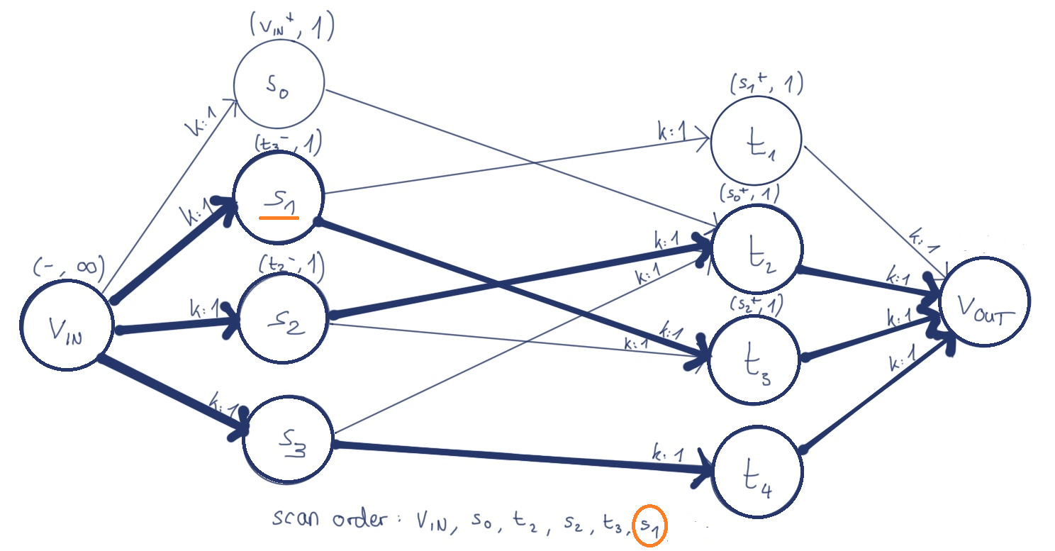
Phase II – Solve the Model
Second Step: Develop an Algorithm
Augmenting Flow Algorithm
LABEL
Scan a labled vertex:
Check each incoming edge $e^{→}$
Lable it if:
$f\left(e^{→}\right)> 0$
$e^{→}$ is unlabled
Check each outgoing
edge $e^{→}, label it if:$
k$\left(e^{→}\right) − f\left(e^{→}\right)> 0$
$e^{→}$ is unlabled
Repeat until all labled vertices are scanned

Slide 30
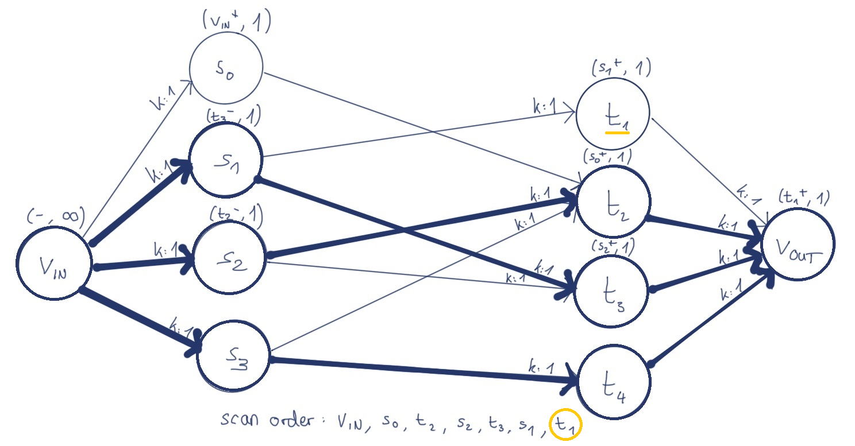
Phase II – Solve the Model
Second Step: Develop an Algorithm
Augmenting Flow Algorithm
LABEL
Scan a labled vertex:
Check each incoming edge $e^{→}$
Lable it if:
$f\left(e^{→}\right)> 0$
$e^{→}$ is unlabled
Check each outgoing
edge $e^{→}, label it if:$
k$\left(e^{→}\right) − f\left(e^{→}\right)> 0$
$e^{→}$ is unlabled
Repeat until all labled vertices are scanned

Slide 31
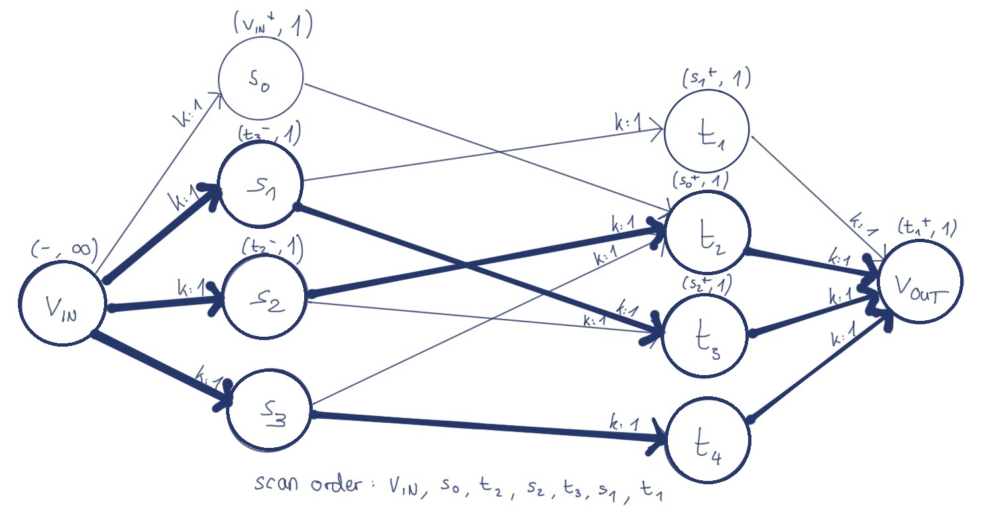
Phase II – Solve the Model
Second Step: Develop an Algorithm
Augmenting Flow Algorithm
LABEL
Scan a labled vertex:
Check each incoming edge $e^{→}$
Lable it if:
$f\left(e^{→}\right)> 0$
$e^{→}$ is unlabled
Check each outgoing
edge $e^{→}, label it if:$
k$\left(e^{→}\right) − f\left(e^{→}\right)> 0$
$e^{→}$ is unlabled
Repeat until all labled vertices are scanned

Slide 32
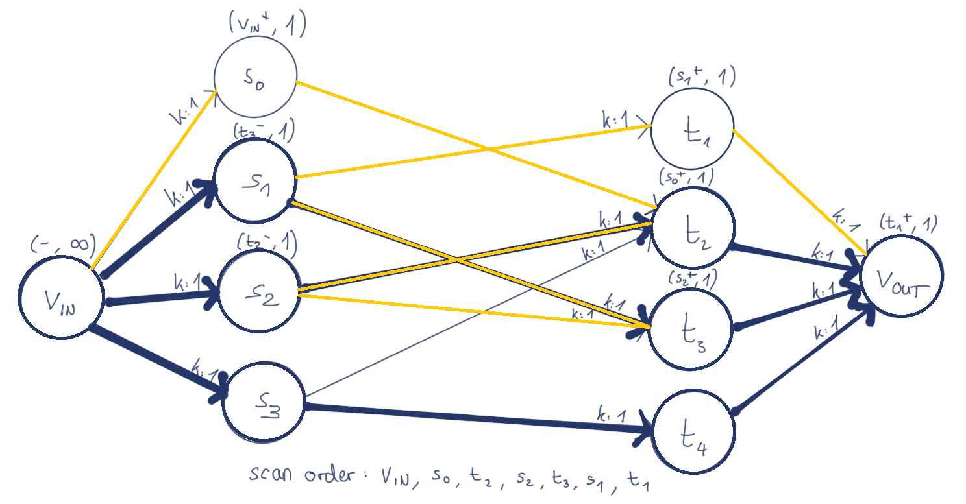
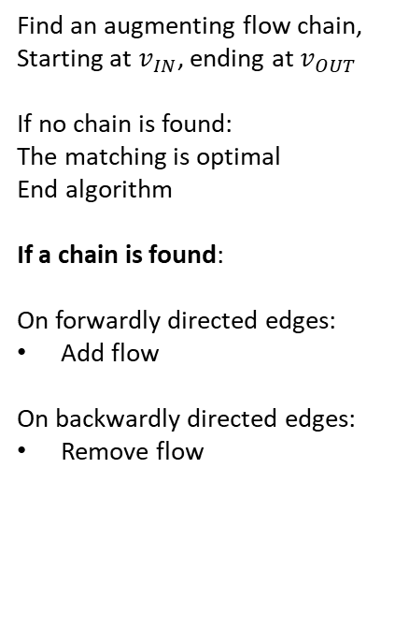
Phase II – Solve the Model
Second Step: Develop an Algorithm
Augmenting Flow Algorithm
CHECK
Find an augmenting flow chain,
Starting at $v_{IN}$, ending at $v_{OUT}$
If no chain is found:
The matching is optimal
End algorithm
If a chain is found:
On forwardly directed edges:
Add flow
On backwardly directed edges:
Remove flow

Slide 33
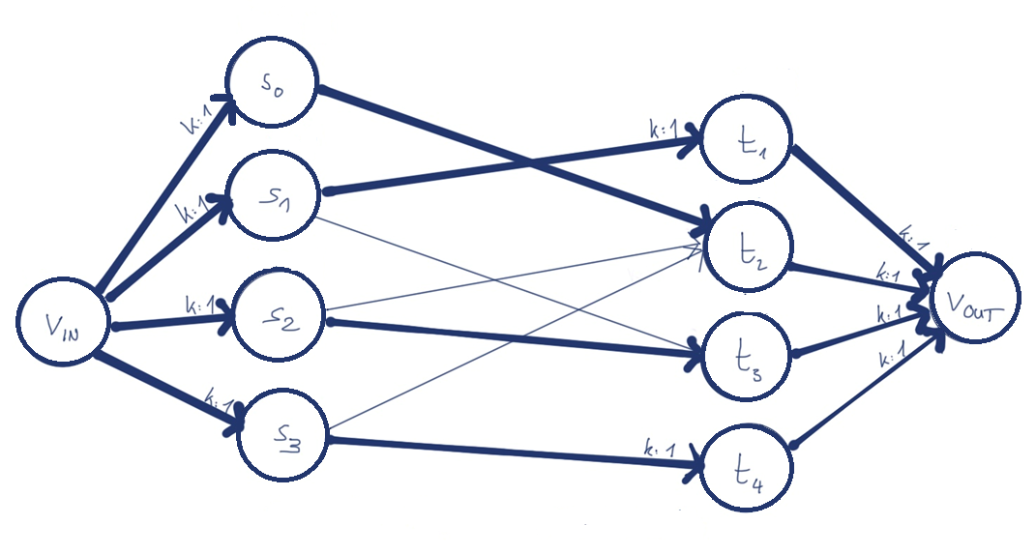
Phase II – Solve the Model
Second Step: Develop an Algorithm
Augmenting Flow Algorithm
CHECK
Find an augmenting flow chain,
Starting at $v_{IN}$, ending at $v_{OUT}$
If no chain is found:
The matching is optimal
End algorithm
If a chain is found:
On forwardly directed edges:
Add flow
On backwardly directed edges:
Remove flow

Slide 34
Phase II – Solve the Model
Second Step: Develop an Algorithm
Augmenting Flow Algorithm
REPEAT
Start again with INIT

Slide 35
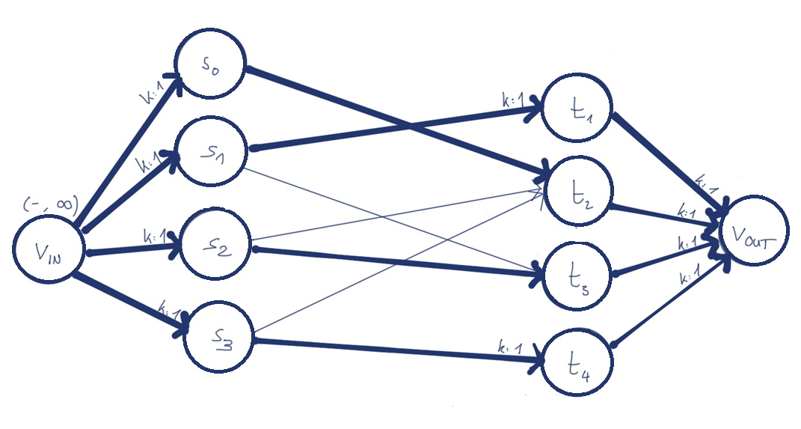
Phase II – Solve the Model
Second Step: Develop an Algorithm
Augmenting Flow Algorithm
INIT
Give $v_{IN}$ a label

Slide 36
Phase II – Solve the Model
Second Step: Develop an Algorithm
Augmenting Flow Algorithm
LABEL
Scan a labled vertex:
Check each incoming edge $e^{→}$
Lable it if:
$f\left(e^{→}\right)> 0$
$e^{→}$ is unlabled
Check each outgoing
edge $e^{→}, label it if:$
k$\left(e^{→}\right) − f\left(e^{→}\right)> 0$
$e^{→}$ is unlabled
Repeat until all labled vertices are scanned

Slide 37
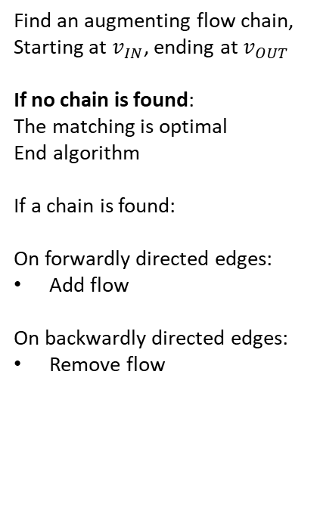
Phase II – Solve the Model
Second Step: Develop an Algorithm
Augmenting Flow Algorithm
CHECK
Find an augmenting flow chain,
Starting at $v_{IN}$, ending at $v_{OUT}$
If no chain is found:
The matching is optimal
End algorithm
If a chain is found:
On forwardly directed edges:
Add flow
On backwardly directed edges:
Remove flow

Slide 38
Phase II – Solve the Model
Second Step: Develop an Algorithm
Augmenting Flow Algorithm
INIT
LABEL
CHECK
REPEAT

Slide 39
After-math: Improvements
We must think of two additional constraints

Slide 40
After-math: Improvements
We must think of two additional constraints
What about priorities?
P1
We make use of a minimization algorithm. It will find the matching with the minimal priority-sum on all optimal matchings.
Not explictly treated in my work
P2
P2
P1
P1
P2

Slide 41
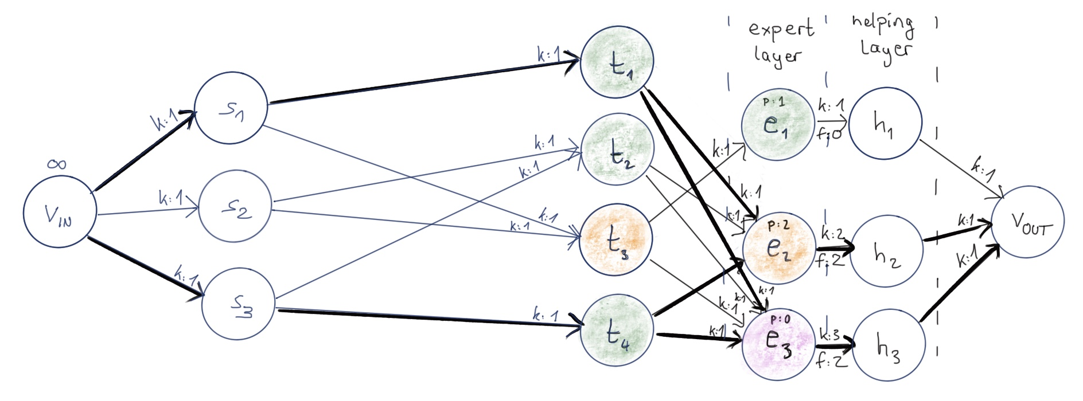
After-math: Improvements
We must think of two additional constraints
Experts have a minimum pensum!
More complicated concepts are needed, explictly treated in my work

Slide 42
After-math: Programming
We’re ready: Let’s program!

Slide 43
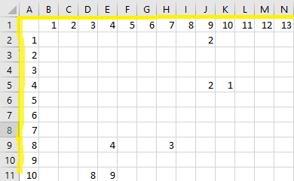
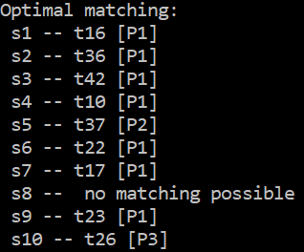
After-math: Programming
We’re ready: Let’s program!
JAVA-Algorithm
CSV-File
Optimal Matching
Mostly adopted from a library

Slide 44
Review: How to assign students to topics

Slide 45
Review: How to assign students to topics
1. Math gives us a model

Slide 46
Review: How to assign students to topics
1. Math gives us a model
2. We model some specific constraints

Slide 47
Review: How to assign students to topics
1. Math gives us a model
2. We model some specific constraints
3. We implement an algorithm

Slide 48
Questions

